Slide 1


FixMatch: Simplifying Semi-Supervised Learning with Consistency and Confidence Kihyuk Sohn, David Berthelot, Chun-Liang Li, Zizhao Zhang, Nicholas Carlini, Ekin D. Cubuk, Alex Kurakin, Han Zhang, Colin Raffel
Notes:
Say only FixMatch

Slide 2
Contents
THIS PRESENTATION
Introduction
Background
FixMatch
Experiments
Ablation Study
Conclusion
MAIN IDEAS
Semi-Supervised Learning
Consistency Regularization
Pseudo-Labeling
For more details, find original paper at https://arxiv.org/abs/2001.07685

Slide 3
INTRODUCTION
1
What is Semi-Supervised Learning?

Slide 4
The main objective of SSL is to overcome the drawbacks of both supervised and unsupervised learning
Notes:
Supervised learning requires huge amount of training data to classify the test data, which is cost effective and time consuming process.
On the other hand, unsupervised learning doesn’t require any labeled data, which clusters the data based on similarity in the data points by using either clustering or maximum likelihood approach. The main downfall of this approach, it can’t cluster an unknown data accurately.

Slide 5
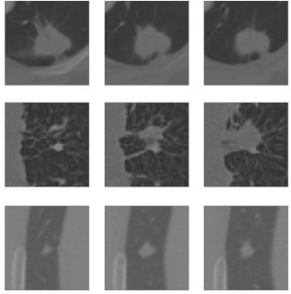
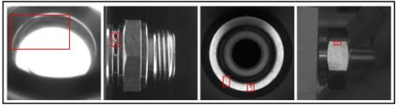
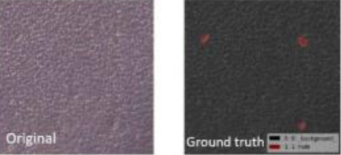
SEMI-SUPERVISED LEARNING
Training on larger datasets produces higher performance, but very expensive!
Sometimes labeled dataset is very small (X -> Y)
A bigger dataset of unlabeled examples is often available (just X’s with no Y labels)
Notes:
We would like to use this large unlabeled dataset for our benefit, to learn association between data points and labels
Like in medical and industrial fields, not much label data

Slide 6
SEMI-SUPERVISED LEARNING
How to use unlabeled dataset to make classification on your labeled data easier
FixMatch combines two approaches to this in smart way i.e. Consistency and Confidence approach

Slide 7
Background
2
Consistency Regularization and Pseodo-Labeling

Slide 8

Consistency Regularization
Popular technique for SSL
The model should output similar predictions when fed perturbed versions of the same image
Notes:
Usually this is done by penalizing the model for making different predictions on data samples after they have been augmented
These augmentation can include things like rotations, flips, color changes etc.

Slide 9
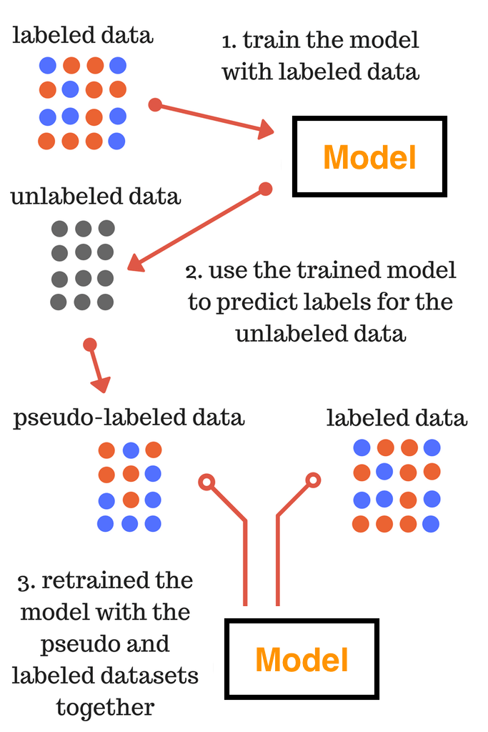
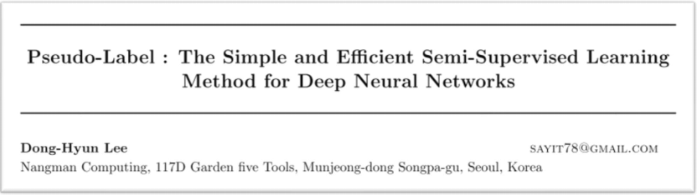
Pseudo-Labeling (self-training)
Pseudo-labeling leverages the idea that we should use the model itself to obtain artificial labels for unlabeled data.
Notes:
Pseudo-labeling specifically refers to the use of “hard” labels (i.e.,the arg max of the model’s output) and only retaining artificial labels whose largest class probability fall above a predefined threshold
For a given image, the pseudo-label is only retained if the model produces a high-confidence prediction

Slide 10
FixMatch
Combining Consistency Regularization and Pseudo-Labeling

Slide 11
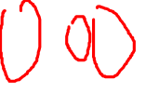
FixMatch
Loss consists of two parts i.e. supervised and unsupervised loss
L = L_{s} + λL_{u}
The magic of FixMatch occurs in unsupervised loss part
Notes:
where λu is a fixed scalar hyperparameter denoting the relative weight of the unlabeled loss
Ls is just cross-entropy between predicted labels y^ and true labels y H(y^, y), and predicted labels can be distributions over labels

Slide 12
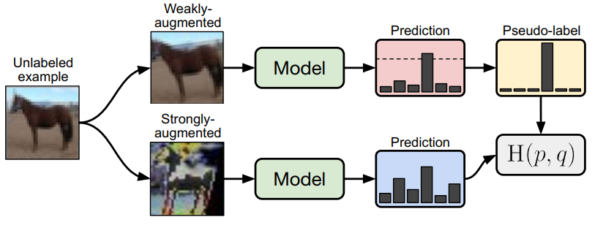
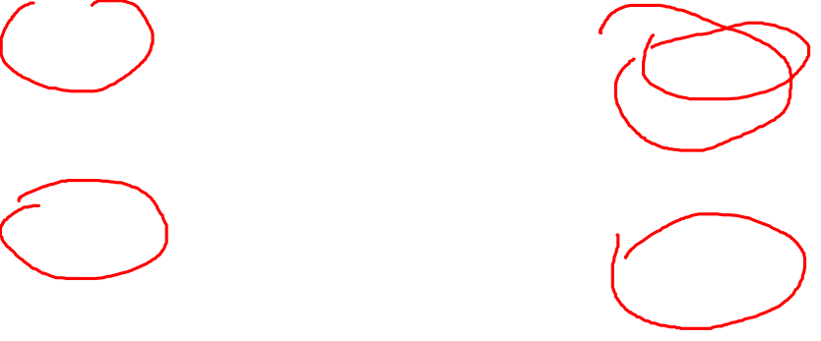
FixMatch
Notes:
Unsupervised loss is going to be H between p and q H(p,q), we will see what this p and q is in a bit
For unsupervised loss, we start with an unlabeled example
Then we have same sample go into two different pipelines i.e. weak and strong augmentation
Here we are dealing with images, so we will talk about image augmentation. It is kind of a cheat to get more data. Cropping, rotate, flips etc.
In the given image, for weakly augmented, they crop, shift and rotate (just to get more data). Then we run through classification model, and we get a prediction. From predictions we take the highest prediction (above a threshold), and that will be our pseudo-label. We take max to get pseudo label y^.
Other pipeline is strong augmentation pipeline. Color, light intensity, contrast, Hue etc. Much more distorted than weakly augmented data. Run through model and get prediction.
Trick is to take the label from weakly augmented, and you take that as it were the true-label. And you form a loss between this new true label, and prediction from strongly augmented pipeline H(p,q)
That is why it is called a pseudo-label, because this a label that we produced from the model itself. For a given image, the pseudo-label is only retained if the model produces a high-confidence prediction
If both pictures were same, it would have been kind of pointless.
One thing that authors are forthcoming about is that they did not invent these techniques, but they combined them

Slide 13
FixMatch
What does this model learn
This paper mainly concerns with the Unsupervised part of the loss function
Model learn to revert the strong augmentation i.e. model basically learns to ignore these kind of augmentations
Interestingly, that really seems to help
Notes:
Unsupervised loss tunes our model to the nature of the data
It says hey model, whenever I give you a weak augmented image and I distort it heavily, I want the label to be the same
Whatever the image, the model at the end of the training will be able to basically map any strongly augmented picture to the same class as a weakly-augmented picture
That is what this loss H(p,q) does
Basically says these kind of augmentations, please ignore them because I always want the same output label as pseudo-label
This unsupervised loss is designed to make the model not distinguish between differently augmented versions of the same image

Slide 14
Experiments
3
Results and comparison

Slide 15
Results on CIFAR-10
Model achieves 94.93% accuracy on CIFAR-10 with just 250 labeled examples
With only 4 labels per class i.e. 40 images with labels, it gets 88.61% accuracy
If we only use one image per class (10 in total), it still gets 78% accuracy
Notes:
compared to the previous semi-supervised state-of-the-art of 93.73% and supervised SOTA of 96-97% with 50,000 examples
Incredible with just 250 examples
With only 4 labels per class i.e. 40 images with lables, it gets 88.61% accuracy, compared to 97% we get with 50,000 images

Slide 16
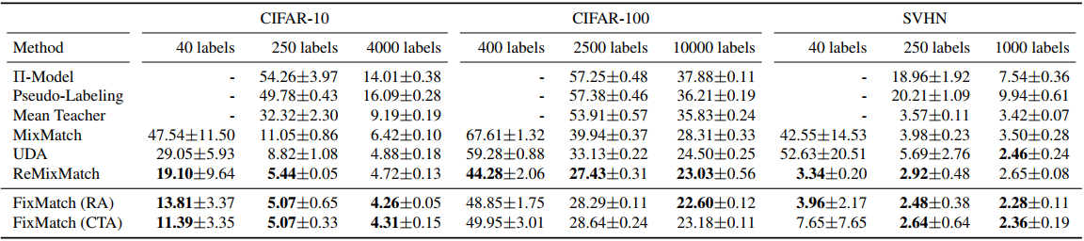
FixMatch vs Supervised Learning
Notes:
Comparison with different percentages of labeled data
In the case of limited labeled data, supervised learning performs very poorly compared to FixMatch

Slide 17
Ablation Studies
4
Important factors to obtain state of the art results

Slide 18
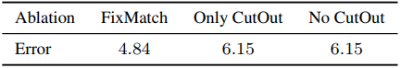
Augmentation Strategy
Augmentation strategy is extremely important
Changing augmentation strategy results in higher error
We find that both CutOut and CTAugment are required to obtain the best performance; removing either results in a comparable increase in error rate

Slide 19
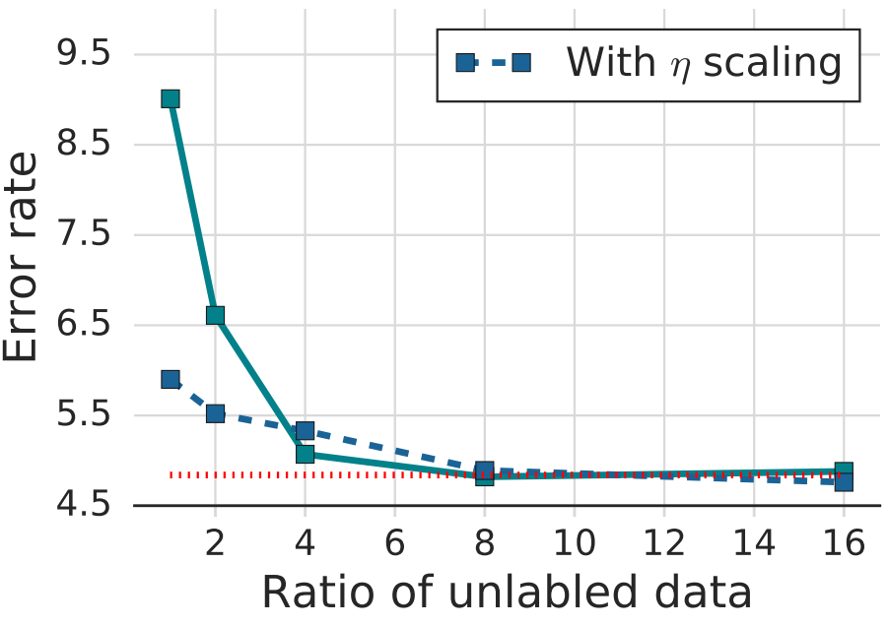
Ratio of unlabeled data
Significant decrease in error rates by using a large amount of unlabeled data

Slide 20
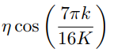
Optimizer and Learning Rate Schedule
Significant decrease in error rates by using a large amount of unlabeled data
SGD+momentum works better than Adam
Cosine learning rate decay
Notes:
Seems to be very important
There are many hyper parameters that seems important

Slide 21
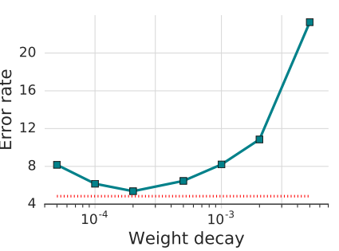
Weight Decay
Tuning the weight decay is exceptionally important
Choosing a value that is just one order of magnitude smaller or larger than the optimal can cost ten percentage points or more
Notes:
Seems to be very important
There are many hyper parameters that seems important

Slide 22
Conclusion
4
Final remarks

Slide 23
Main Contributions
Introduce FixMatch which produces artificial labels using both pseudo-labeling and consistency regularization
Achieves state-of-the-art results across many datasets
Include ablation study to determine which factors contribute the most to its success

Slide 24
Main Contributions
Gains are substantial sometimes, but not through the roof substantial
It is unclear how much actually comes from this clever combination that FixMatch proposes
And how much comes from whether you set the hyper parameters correctly
Notes:
How much computations are you able to throw at selecting your hyper-parameters
That seems to be a bit of a pain point for me
This kind of research where you are trying for 1 percentage improvement in accuracy while single misstep might cost you 10 times the gain is a bit sketchy
They got the best numbers, but where exactly do these numbers come from? The architecture or more from throwing computers at it

Slide 25
References
Sohn, Kihyuk, et al. "Fixmatch: Simplifying semi-supervised learning with consistency and confidence." arXiv preprint arXiv:2001.07685 (2020).
Reddy, Y & Pulabaigari, Viswanath & B, Eswara. (2018). Semi-supervised learning: a brief review. International Journal of Engineering & Technology. 7. 81. 10.14419/ijet.v7i1.8.9977.
H Scudder. Probability of error of some adaptive pattern recognition machines. IEEE Transactions on Information Theory, 11(3), 1965.
Geoffrey J. McLachlan. Iterative reclassification procedure for constructing an asymptotically optimal rule of allocation in discriminant analysis. Journal of the American Statistical Association, 70(350):365–369, 1975.
Sajjadi, Mehdi et al. “Regularization With Stochastic Transformations and Perturbations for Deep Semi-Supervised Learning.” NIPS (2016).
Lee, Dong-Hyun. (2013). Pseudo-Label : The Simple and Efficient Semi-Supervised Learning Method for Deep Neural Networks. ICML 2013 Workshop: Challenges in Representation Learning (WREPL).

